Slide 1
Machine Learning DSECL ZG565
Support Vector Machines –II
Dr. Monali Mavani
These slides are prepared by the instructor, with grateful acknowledgement of Prof. Tom Mitchell, Prof.. Burges, Prof. Andrew Moore and many others who made their course materials freely available online

Slide 2
Topics to be covered
Soft Margin SVM
Nonlinear SVM
Kernel Trick
SVM Kernels
Multi-Class Problem
SVM vs Logistic Regression
SVM Applications

Slide 3
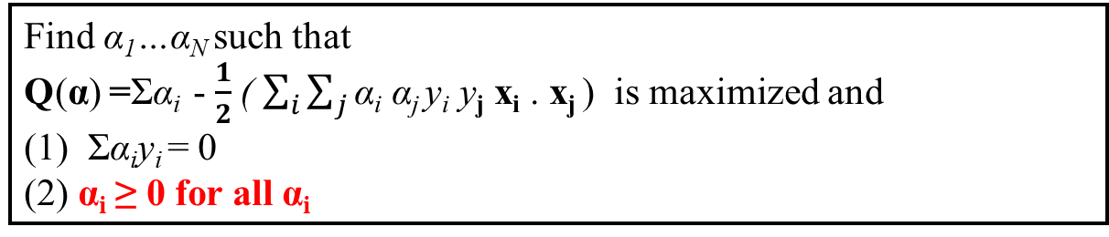
Linear SVMs: Overview
The classifier is a separating hyperplane.
Most “important” training points are support vectors; they define the decision hyperplane (unlike other algorithms like linear regression, ANN etc. where all training points determine decision hyperplane)
Quadratic optimization algorithms can identify which training points x_{i} are support vectors with non-zero Lagrangian multipliers α_{i}.
Both in the dual formulation of the problem and in the solution training points appear only inside dot products:
Find α₁…α_{N} such that
Q(α) =Σα_{i} - $\frac{1}{2}$( $\sum_{i}{\sum_{j}{\text{α}\text{i} \text{α}\text{j} \text{y}\text{i} \text{y}\text{j} \text{x}\text{i}\text{ . }\text{x}\text{j} \text{)} }}$is maximized and
(1) Σα_{i}y_{i} = 0
(2) α_{i} ≥ 0 for all α_{i}
f(x) = Σα_{i}y_{i}x_{i}^{T}x + b

Slide 4
Dataset with noise
denotes +1
denotes -1
Hard Margin: So far we require all data points be classified correctly
- No training error
What if the training set is noisy?

Slide 5
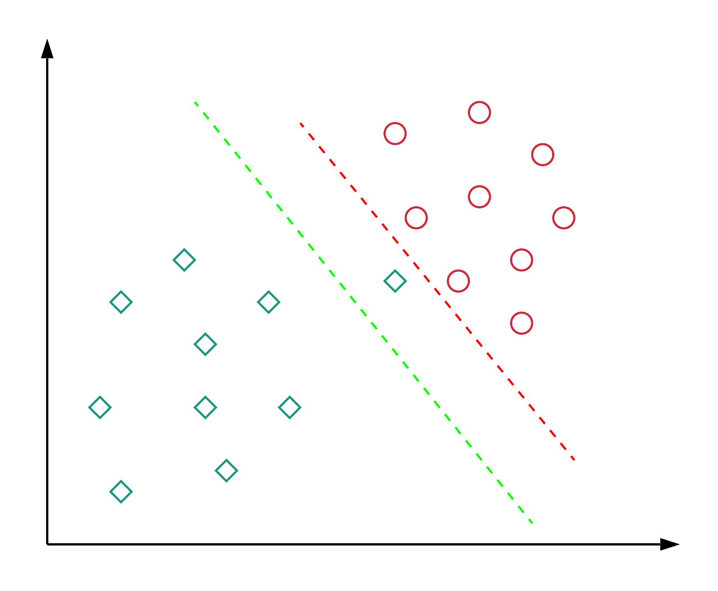
Motivation : Softmargin
Almost all real-world applications have data that is linearly inseparable.
When data is linearly separable, choosing perfect decision boundary leads to overfitting

Slide 6
Soft Margin Classification
Slack variables ξ_{i} can be added to allow misclassification of difficult or noisy examples.
slack variable ξ_{i} for every data point x_{i},
ξ_{i} is the distance of x_{i} from the corresponding class’s margin if x_{i} is on the wrong side of the margin, otherwise zero. It can be regarded as a measure of confidence
Points that are far away from the margin on the wrong side would get more penalty
ε₃
ε₂
wx+b=1
ε₁
wx+b=0
wx+b=-1

Slide 7
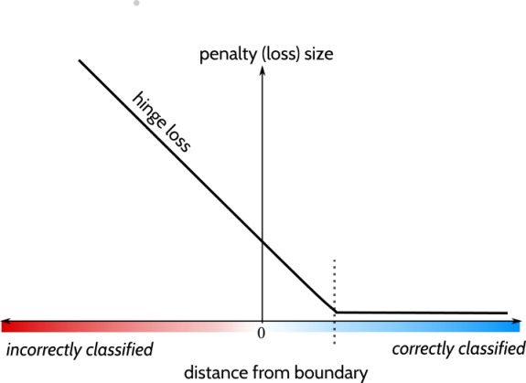
Slack variable-Hinge loss
y_{i}f (x_{i})

Slide 8




Introduce “slack” variables
ξ_{i} ≥ 0
ξ_{i}
>
2
||w||
||w||
Margin = ²
||w||
for 0 < ξ ≤ 1 : point is between margin and correct side of hyper- plane. This is a margin violation
for ξ > 1 point is misclassified
Misclassified point
ξ_{i}
<
1
||w||
||w||
Support Vector
ξ = 0
w^{T}x + b = 1
w
w^{T}x + b = 0
w^{T}x + b = -1

Slide 9
Soft Margin Classification
What should our quadratic optimization criterion be?
Minimize
C is a constant for L1 regularization to control effect of slack variable
Parameter C can be viewed as a way to control overfitting
When C is large, larger slacks penalize the objective function of SVM’s more than when C is small.
Hard margin SVMs do not allow for misclassifications and do not require regularization.

Slide 10
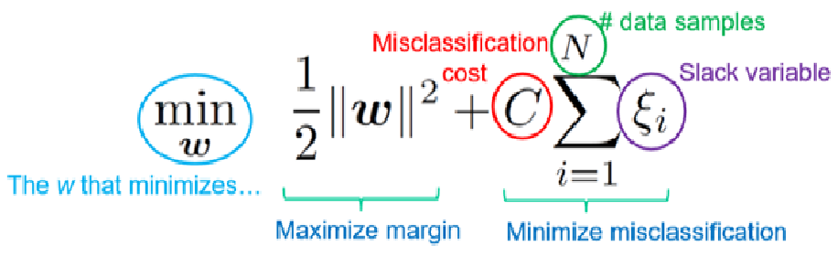
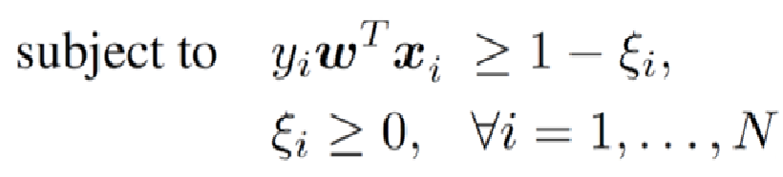
Soft Margin SVMs

Slide 11
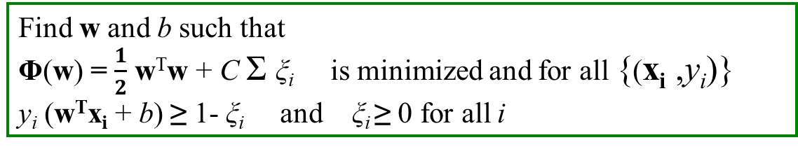
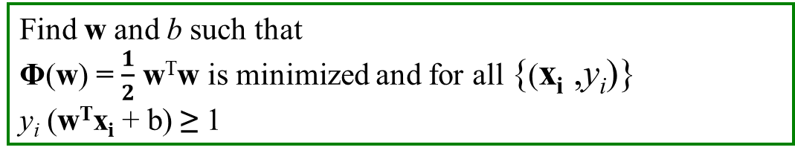
Hard Margin versus Soft Margin
Hard Margin:
Soft Margin incorporating slack variables:
Corresponding Lagrangian function
Find w and b such that
Φ(w) = $\frac{1}{2}$ w^{T}w is minimized and for all {(x_{i} ,y_{i})}
y_{i} (w^{T}x_{i} + b) ≥ 1
Find w and b such that
Φ(w) = $\frac{1}{2}$ w^{T}w + C Σ ξ_{i} is minimized and for all {(x_{i} ,y_{i})}
y_{i} (w^{T}x_{i} + b) ≥ 1- ξ_{i} and ξ_{i} ≥ 0 for all i

Slide 12
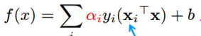
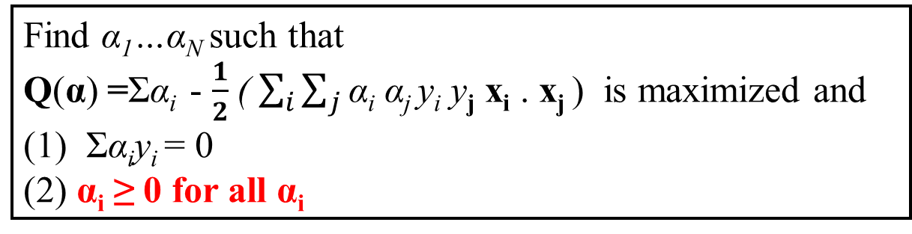
Soft Margin Vs Hard margin Classification – Solution
Find α₁…α_{N} such that
Q(α) =Σα_{i} - ½ΣΣα_{i}α_{j}y_{i}y_{j}x_{i}^{T}x_{j} is maximized and
(1) Σα_{i}y_{i} = 0
(2) 0 ≤ α_{i} ≤ C for all α_{i}
The dual problem
Solution to the dual problem
f(x) = Σα_{i}y_{i}x_{i}^{T}x + b
w = Σα_{i}y_{i}x_{i}
b = y_{k}(1- ξ_{k}) - w^{T}x_{k} where k = argmax α_{k’}
Find α₁…α_{N} such that
Q(α) =Σα_{i} - $\frac{1}{2}$( $\sum_{i}{\sum_{j}{\text{α}\text{i} \text{α}\text{j} \text{y}\text{i} \text{y}\text{j} \text{x}\text{i}\text{ . }\text{x}\text{j} \text{)} }}$is maximized and
(1) Σα_{i}y_{i} = 0
(2) α_{i} ≥ 0 for all α_{i}
The dual problem
Solution to the
dual problem
w = Σ α_{i} y_{i} x_{i}
b = y_{i} – W.x_{i}

Slide 13
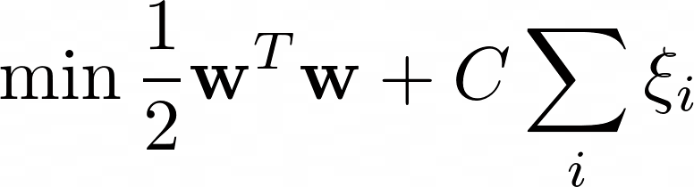
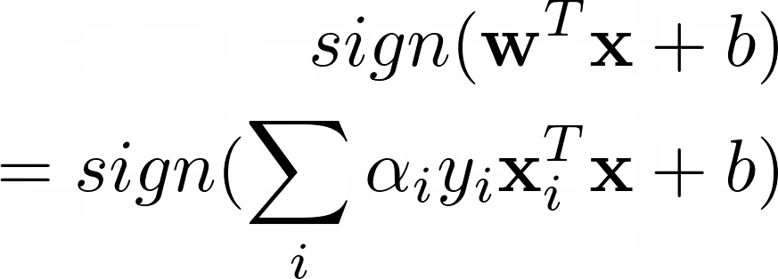
SVM Problem
SVM: Training
Input: (X,y), C
Output: alpha for support vectors, b
Hyperparameter : C
High C (= inf) - smaller margin, large penalties
Low C (=0) - Larger margin, small penalties
C parameter tells the SVM optimization how much you want to avoid misclassifying each training example.
SVM: Testing

Slide 14
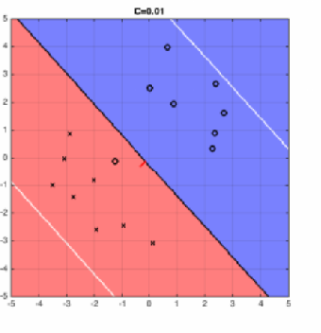
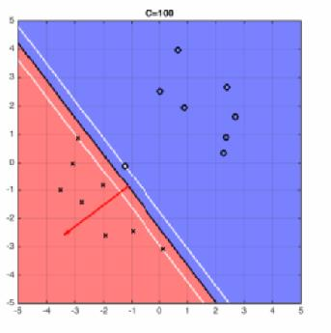
Effect of C
For large values of C, the optimization will choose a smaller-margin hyperplane if that hyperplane does a better job of getting all the training points classified correctly.
small value of C will cause the optimizer to look for a larger-margin separating hyperplane, even if that hyperplane misclassifies more points.

Slide 15
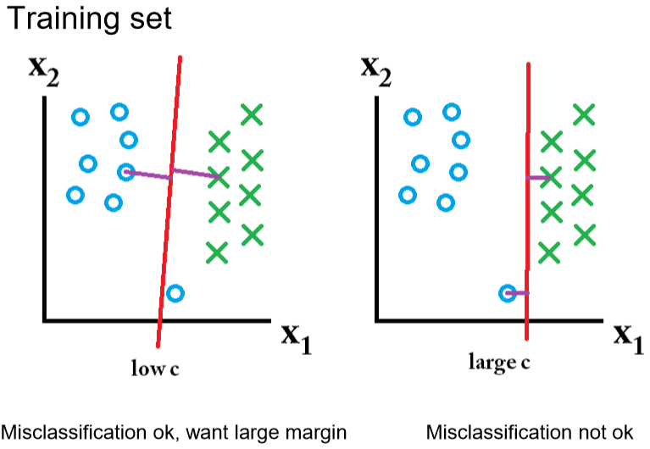
Effect of Margin size v/s misclassification cost
classification mistakes are given
less importance,
the focus is more on avoiding misclassification at the expense of keeping the margin small.

Slide 16
Nonlinear SVM - kernels

Slide 17
Non-linear SVMs
What if data is not noisy or having outliers(soft margin can work) but inherently non linear
Datasets that are linearly separable with some noise soft margin work out great:
But what are we going to do if the dataset is just too hard?
How about… mapping data to a higher-dimensional space:
0
x
0
x
x²
x
0

Slide 18
Non-linear SVMs:
Feature spaces
General idea: the original input space can always be mapped to some higher-dimensional feature space where the training set is separable:
Φ: x → φ(x)

Slide 19
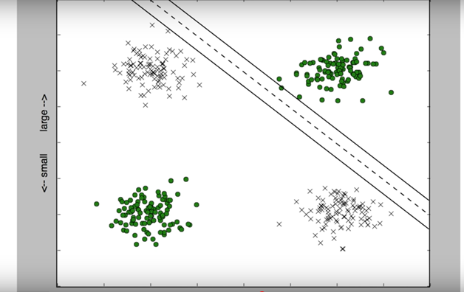
Non-linear SVMs

Slide 20
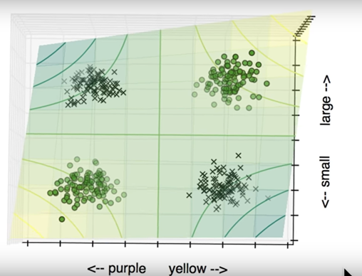
Non-linear SVMs: Feature spaces

Slide 21
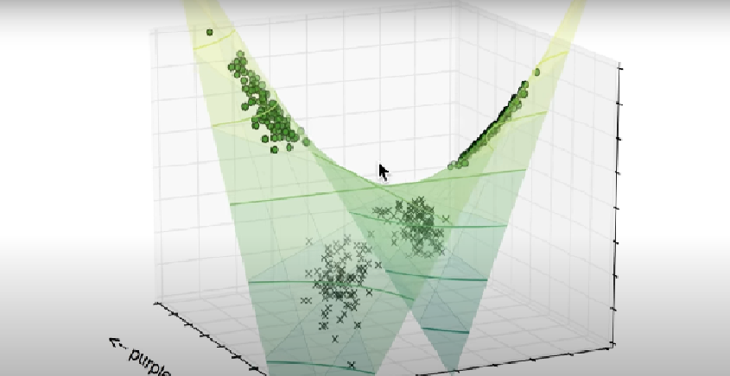
Non-linear SVMs: Feature spaces

Slide 22
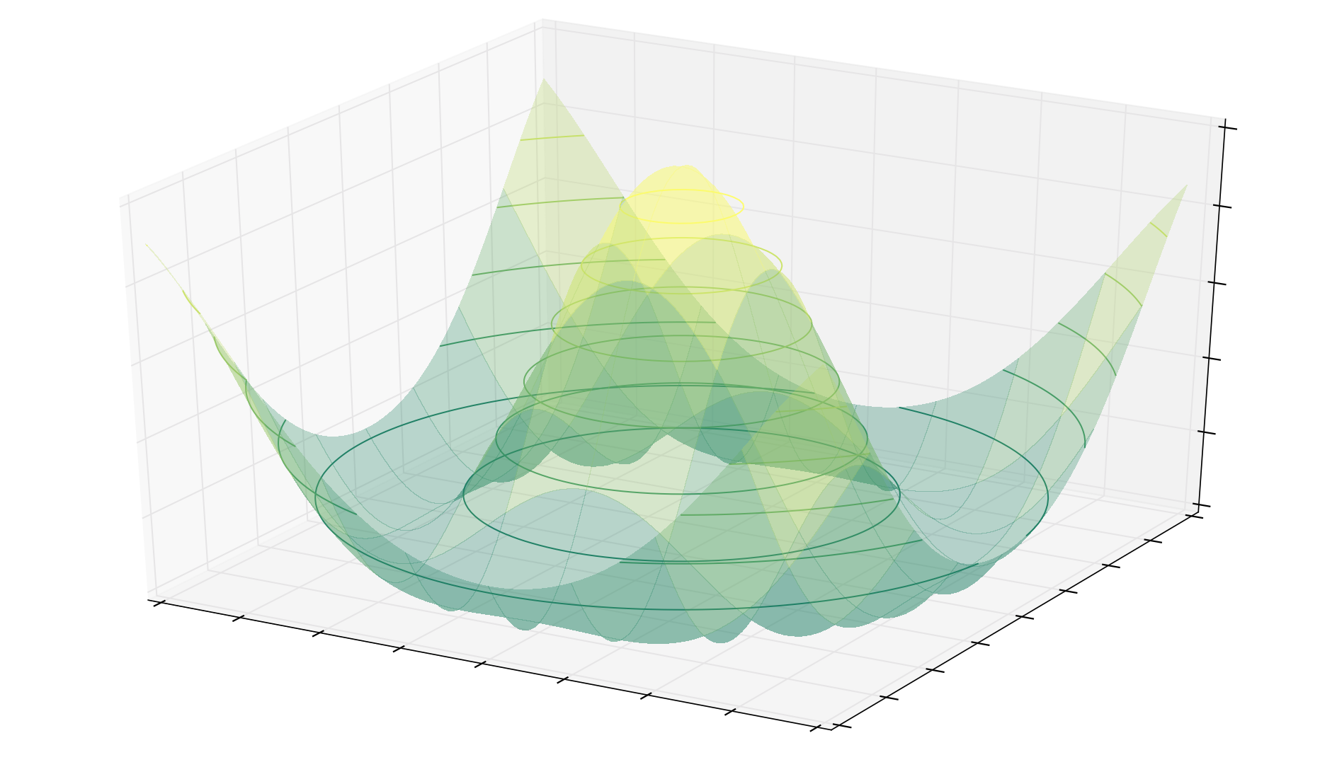
Non-linear SVMs: Feature spaces

Slide 23
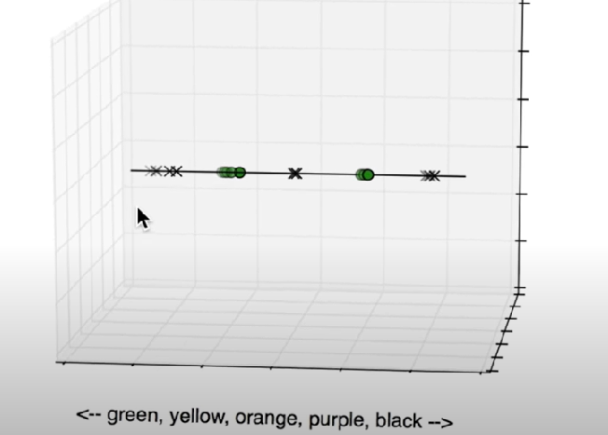
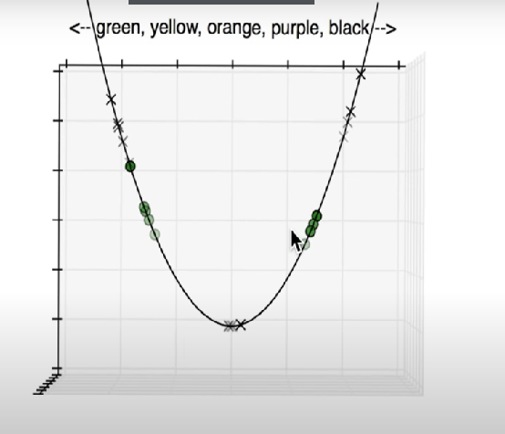

Slide 24
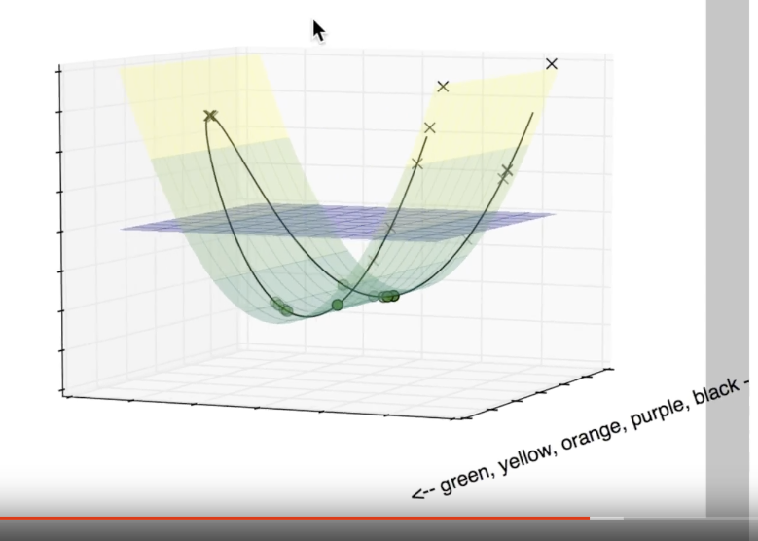

Slide 25
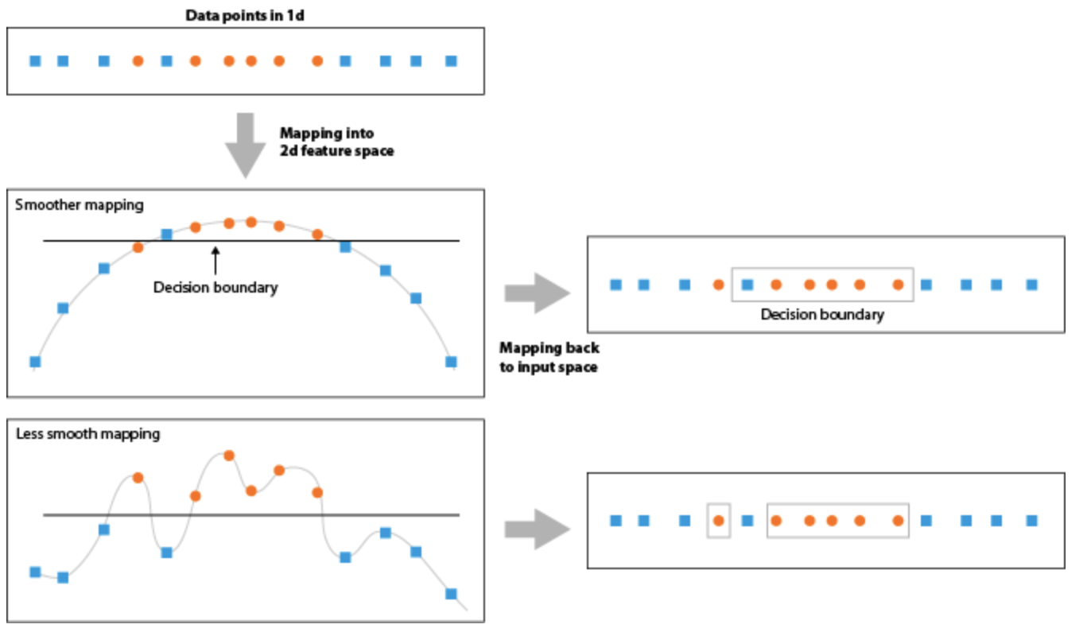

Slide 26

Mapping into a New Feature Space
Φ : x → X = Φ(x)
Φ(x₁,x₂) = (x₁,x₂,x₁²,x₂²,x₁x₂)
Rather than run SVM on x_{i}, run it on Φ(x_{i})
Find non-linear separator in input space
What if Φ(x_{i}) is really big?
Use kernels to compute it implicitly!
Image from http://web.engr.oregonstate.edu/
~afern/classes/cs534/

Slide 27
Transforming the Data
φ( )
φ( )
φ( )
φ( )
φ( )
φ(.)
φ( )
φ( )
φ( )
φ( )
φ( )
φ( )
φ( )
φ( )
φ( )
φ( )
φ( )
φ( )
φ( )
Input space
Feature space
Note: feature space is of higher dimension than the input space in practice
Computation in the feature space can be costly because it is high dimensional
The feature space is typically infinite-dimensional!
The kernel trick comes to rescue

Slide 28
SVM Kernels
SVM algorithms use a set of mathematical functions that are defined as the kernel.
Function of kernel is to take data as input and transform it into the required form.
Different SVM algorithms use different types of kernel functions. Example linear, nonlinear, polynomial, and sigmoid etc.

Slide 29
The “Kernel Trick”
The linear classifier relies on dot product between vectors
x_{i}^{T} . x_{j}
If every data point is mapped into high-dimensional space via some transformation Φ: x → φ(x), the dot product becomes:
K(x_{i}, x_{j})= φ(x_{i})^{T} φ (x_{j})
A kernel function is some function that corresponds to an inner product in some expanded feature space.
Computing K(x1,x2) should be efficient, much more so than computing Φ(x1) and Φ(x2)

Slide 30
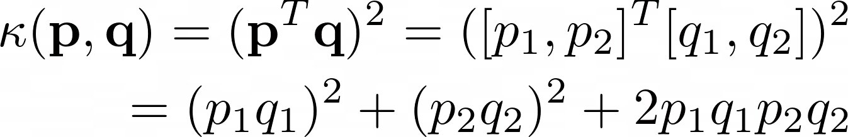
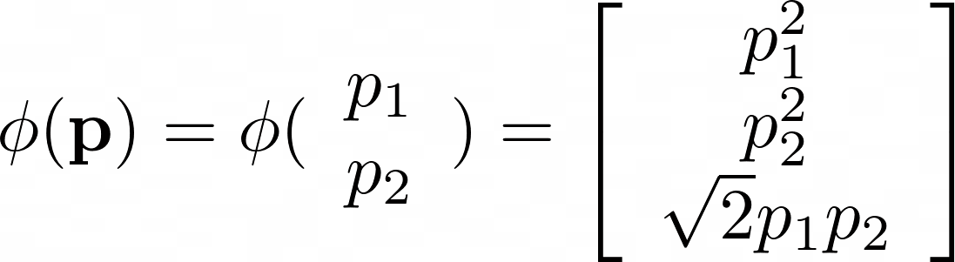
Kernel: Example Polynomial Kernel
This is equivalent to:

Slide 31
Example:
2-dimensional vectors x=[x₁ x₂];
let K(x_{i},x_{j})=(1 + x_{i}^{T}x_{j})²,
Need to show that K(x_{i},x_{j})= φ(x_{i}) ^{T}φ(x_{j}):
K(x_{i},x_{j})=(1 + x_{i}^{T}x_{j})²,
= 1+ x_{i1}²x_{j1}² + 2 x_{i1}x_{j1} x_{i2}x_{j2}+ x_{i2}²x_{j2}² + 2x_{i1}x_{j1} + 2x_{i2}x_{j}
= [1 x_{i1}² √2 x_{i1}x_{i2} x_{i2}² √2x_{i1} √2x_{i2}]^{T} [1 x_{j1}² √2 x_{j1}x_{j2} x_{j2}² √2x_{j1} √2x_{j2}]
= φ(x_{i}) ^{T}φ(x_{j}),
where φ(x) = [1 x₁² √2 x₁x₂ x₂² √2x₁ √2x₂]
Thus, a kernel function implicitly maps data to a high-dimensional space (without the need to compute each φ(x) explicitly).

Slide 32
Mercer kernels
What functions are valid kernels that correspond to feature vectors φ(x)?
Mercer kernels K
• K is continuous
• K is symmetric
• K is positive semi-definite, i.e. x^{T}Kx ≥ 0 for all x
Ensures optimization is concave maximization

Slide 33
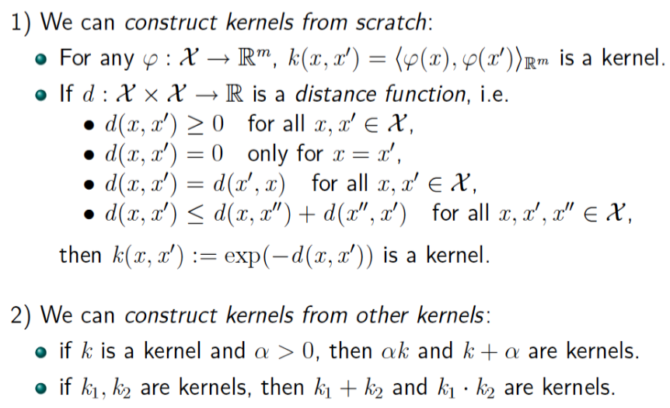
What Functions are Kernels?

Slide 34
Examples of Kernel Functions
Linear: K(x_{i},x_{j})= x_{i} ^{T}x_{j}
Polynomial of power p: K(x_{i},x_{j})= (1+ x_{i} ^{T}x_{j})^{p}
Gaussian (radial-basis function network):
Sigmoid: K(x_{i},x_{j})= tanh(β₀x_{i} ^{T}x_{j} + β₁)

Slide 35
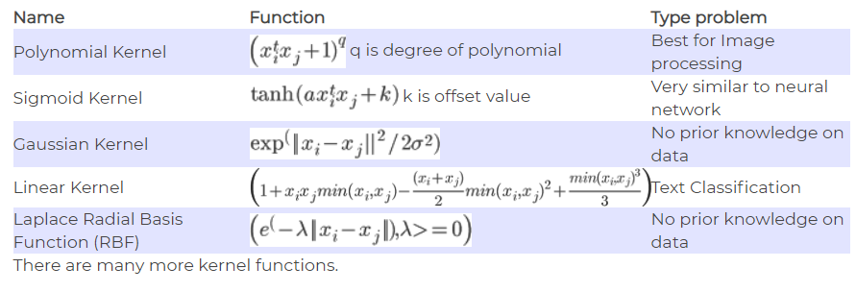

Slide 36
Using a Different Kernel in the Dual Optimization Problem
f(x) = Σα_{i}y_{i}K(x_{i}, x_{j})+ b
For example, using the polynomial kernel with d = 4 (including lower-order terms).
Maximize over α
W(α) = Σ_{i} α_{i} - 1/2 Σ_{i,j} α_{i} α_{j} y_{i} y_{j} <x_{i}, x_{j}>
Subject to
α_{i} ≥ 0
Σ_{i} α_{i} y_{i} = 0
Decision function
f(x) = sign(Σ_{i} α_{i} y_{i} <x, x_{i}> + b)
(<x_{i}, x_{j}> + 1)⁴
These are kernels!
(<x_{i}, x_{j}> + 1)⁴
So by the kernel trick,
we just replace them!

Slide 37
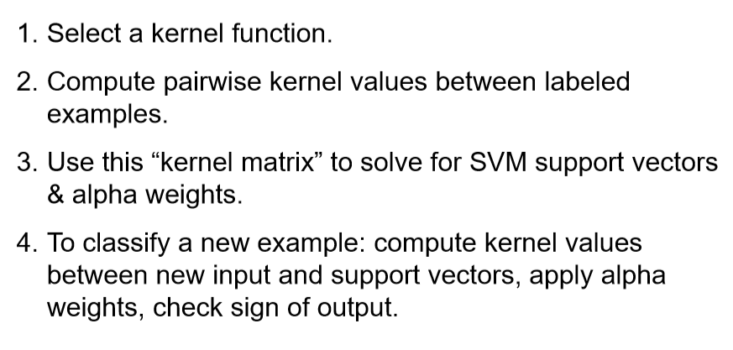
Non-linear SVM using kernel

Slide 38
Nonlinear SVM - Overview
SVM locates a separating hyperplane in the feature space and classify points in that space
It does not need to represent the space explicitly, simply by defining a kernel function
The kernel function plays the role of the dot product in the feature space.

Slide 39
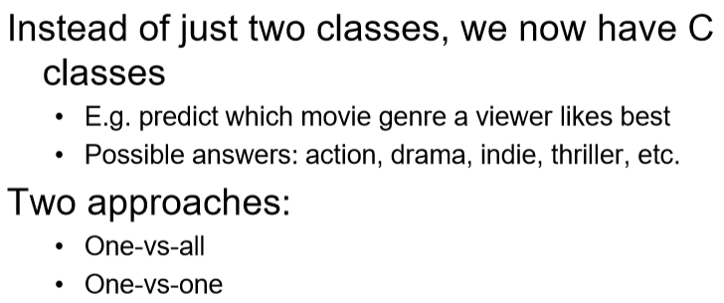
Multi-Class Problem

Slide 40
Multi-Class Problem

Slide 41
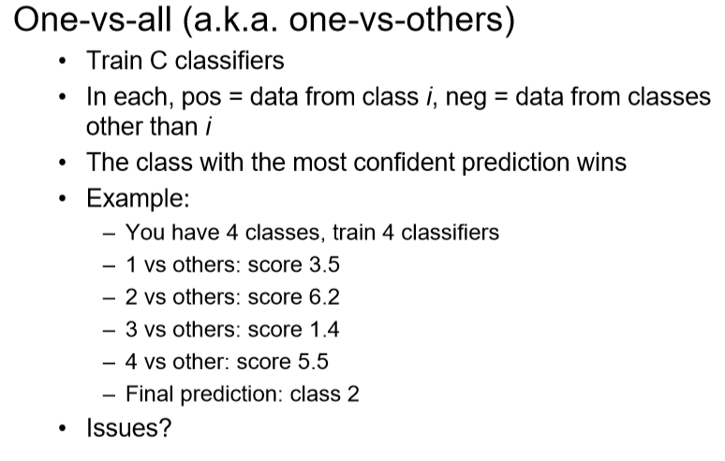
Multi-Class Problem

Slide 42
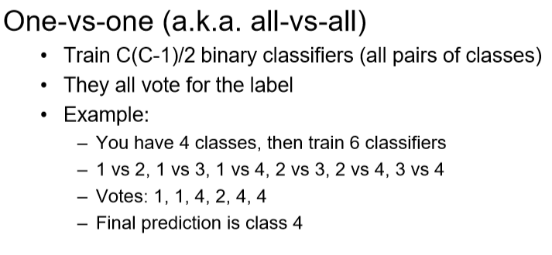
Multi-Class Problem

Slide 43
SVM versus Logistic Regression
Logistic regression focuses on maximizing the probability of the data. The farther the data lies from the separating hyperplane (on the correct side), the happier LR is
An SVM tries to find the separating hyperplane that maximizes the distance of the closest points to the margin (the support vectors). If a point is not a support vector, it doesn’t really matter.

Slide 44
Which one to use?
As always, depends on your problem.
LR gives calibrated probabilities that can be interpreted as confidence in a decision.
LR gives us an unconstrained, smooth objective
LR can be (straightforwardly) used within Bayesian models.
SVMs don’t penalize examples for which the correct decision is made with sufficient confidence. This may be good for generalization.
SVMs have a nice dual form, giving sparse solutions when using the kernel trick (better scalability).

Slide 45
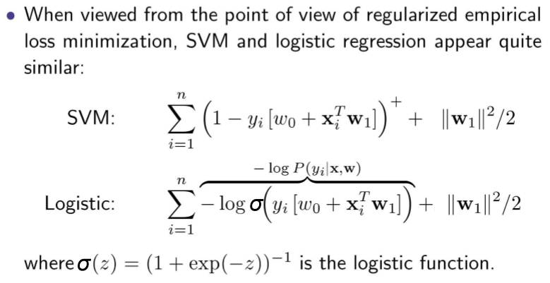
SVM versus Logistic Regression
Hinge Loss
Objective function

Slide 46
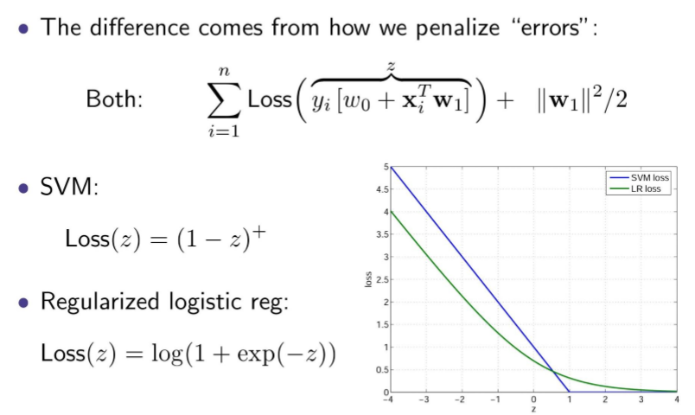
SVM versus Logistic Regression

Slide 47
Properties of SVM
Flexibility in choosing a similarity function
Sparseness of solution when dealing with large data sets
- Only support vectors are used to specify the separating hyperplane
Therefore SVM also called sparse kernel machine.
Ability to handle large feature spaces
- complexity does not depend on the dimensionality of the feature space
Overfitting can be controlled by soft margin approach
Nice math property: a simple convex optimization problem which is guaranteed to converge to a single global solution
Feature Selection

Slide 48
Strengths of SVMs
Good generalization in theory
Good generalization in practice
Work well with few training instances
Find globally best model
Efficient algorithms
Amenable to the kernel trick

Slide 49

How can it break?
Data with lots of error.
Discriminator location depends entirely on the few nearest data points.
Choosing the wrong kernel.
Kernel selection is trial and error.
Large data sets.
Calculating the kernel is expensive.
Each of these requires a human in the loop to make judgment calls.

Slide 50
SVM Points to remember
Primal and Dual optimization problems
Kernel functions
Support Vector Machines
Maximizing margin
Derivation of SVM formulation
Slack variables and hinge loss
Relationship between SVMs and logistic regression
0/1 loss
Hinge loss
Log loss

Slide 51
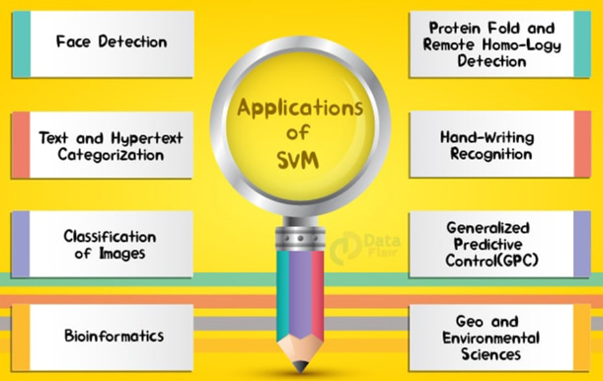
SVM Applications
SVM has been used successfully in many real-world problems

Slide 52
Application : Text Categorization
Task: The classification of natural text (or hypertext) documents into a fixed number of predefined categories based on their content.
A document can be assigned to more than one category, so this can be viewed as a series of binary classification problems, one for each category

Slide 53
Text Categorization using SVM
The distance between two documents is φ(x)·φ(z)
K(x,z) = φ(x)·φ(z) is a valid kernel, SVM can be used with K(x,z) for discrimination.
Why SVM?
-High dimensional input space
-Few irrelevant features (dense concept)
-Sparse document vectors (sparse instances)
-Text categorization problems are linearly separable

Slide 54
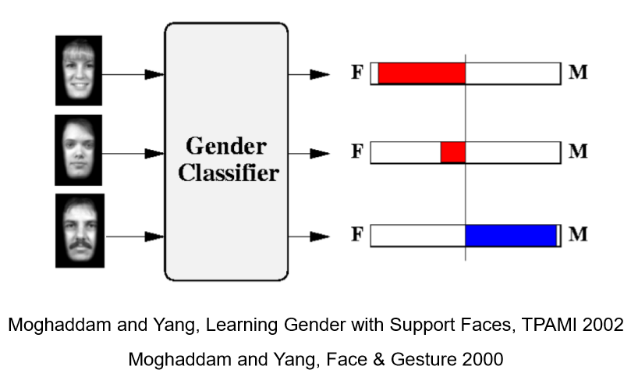
Learning Gender from image with SVM

Slide 55
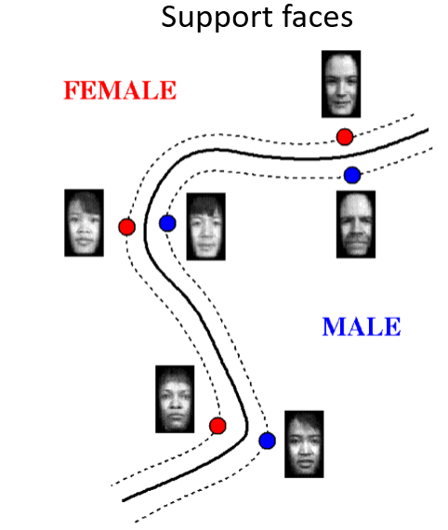
Support faces

Slide 56
Some Issues
Sensitive to noise
- A relatively small number of mislabeled examples can dramatically decrease the performance
Choice of kernel
- Gaussian or polynomial kernel is default
- if ineffective, more elaborate kernels are needed
- domain experts can give assistance in formulating appropriate similarity measures
Choice of kernel parameters
- e.g. σ in Gaussian kernel
- σ is the distance between closest points with different classifications
- In the absence of reliable criteria, applications rely on the use of a validation set or cross-validation to set such parameters.
Optimization criterion – Hard margin v.s. Soft margin
- a lengthy series of experiments in which various parameters are tested

Slide 57
Reference
Support Vector Machine Classification of Microarray Gene Expression Data, Michael P. S. Brown William Noble Grundy, David Lin, Nello Cristianini, Charles Sugnet, Manuel Ares, Jr., David Haussler
Text categorization with Support Vector Machines: learning with many relevant features
T. Joachims, ECML - 98
Christopher Bishop: Pattern Recognition and Machine Learning, Springer International Edition
A Tutorial on Support Vector Machines for Pattern Recognition, Kluwer Academic Publishers - Christopher J.C. Burges

Slide 58
Good Web References for SVM
http://www.cs.utexas.edu/users/mooney/cs391L/
https://www.coursera.org/learn/machine-learning/home/week/7
https://towardsdatascience.com/support-vector-machine-introduction-to-machine-learning-algorithms-934a444fca47
https://data-flair.training/blogs/svm-kernel-functions/
MIT 6.034 Artificial Intelligence, Fall 2010
https://stats.stackexchange.com/questions/30042/neural-networks-vs-support-vector-machines-are-the-second-definitely-superior
https://www.sciencedirect.com/science/article/abs/pii/S0893608006002796
https://medium.com/deep-math-machine-learning-ai/chapter-3-support-vector-machine-with-math-47d6193c82be
Radial basis kernel
http://www.engr.mun.ca/~baxter/Publications/LagrangeForSVMs.pdf

Slide 59
Thank You
13 March 2022

